Slide 1
Food and Nutrition Services Updates
Economical Services Committee
June 12, 2024
Cynthia Ervin, Assistant Director, FNS
Cynthia.ervin@dhhs.nc.gov
Jerquitta Hicks Smallwood, Deputy Director, FNS
Jerquitta.smallwood@dhhs.nc.gov

Slide 2
SUN Bucks
1

Slide 3
REMINDER! MOST STUDENTS WILL AUTOMATICALLY QUALIFY FOR SUN BUCKS
980k
North Carolina students expected to be automatically eligible in 2024
Students may be automatically eligible for SUN Bucks if they participate in at least one of the following programs and do NOT need to apply:
National School Lunch Program (NSLP) free or reduced-price (FRP) school meals
Food and Nutrition Services (FNS, food stamps)
Work First (TANF, cash assistance)
Medicaid with household income below 185% of the federal poverty level
Foster care
Automatically eligible household
Application
SUN Bucks benefits
How will families know if one or more of their children are automatically eligible?
Electronic communications: Households will receive an Eligibility Notice or Invitation to Apply, as applicable, via robocall, text, and email from NCDHHS in early to mid-June.
Chatbot coming soon: the SUN Bucks chatbot will have an eligibility quiz, which can show if a child would be automatically eligible or if they need to apply.

Slide 4
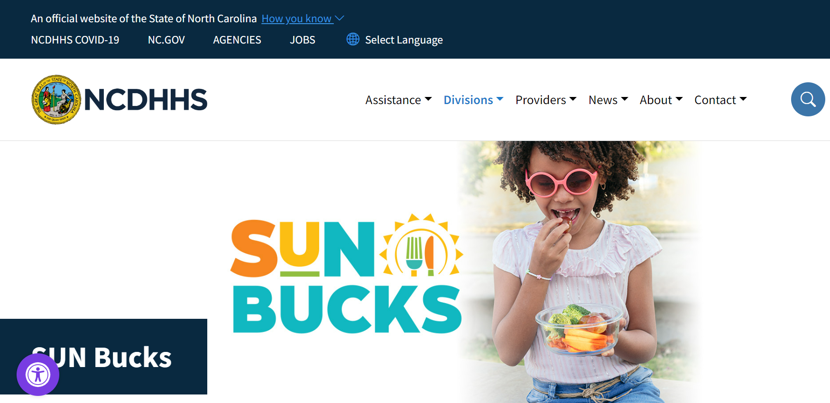
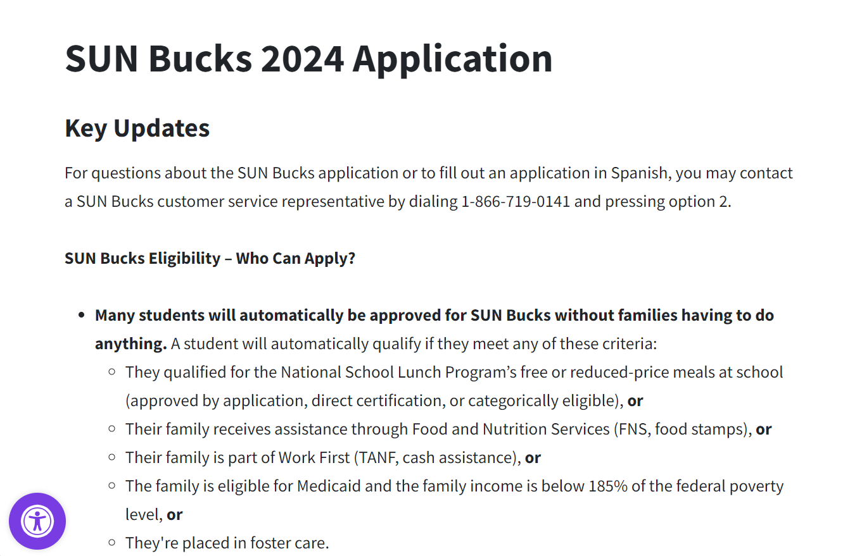
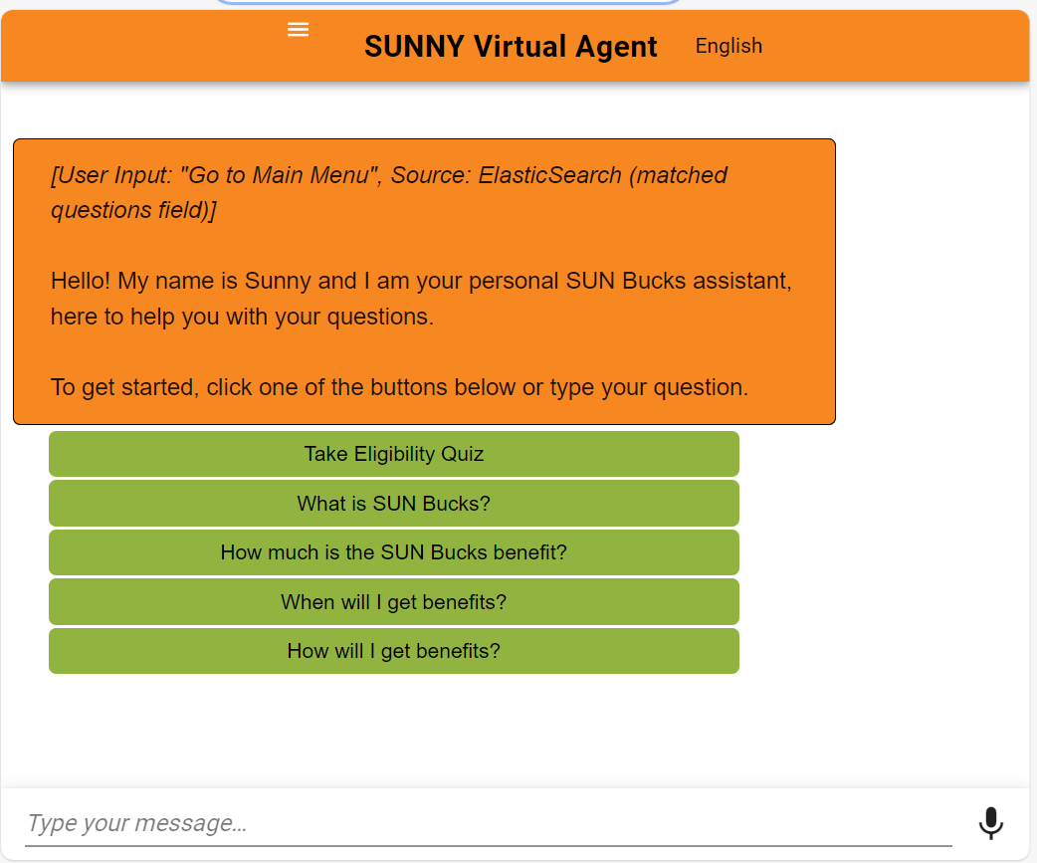
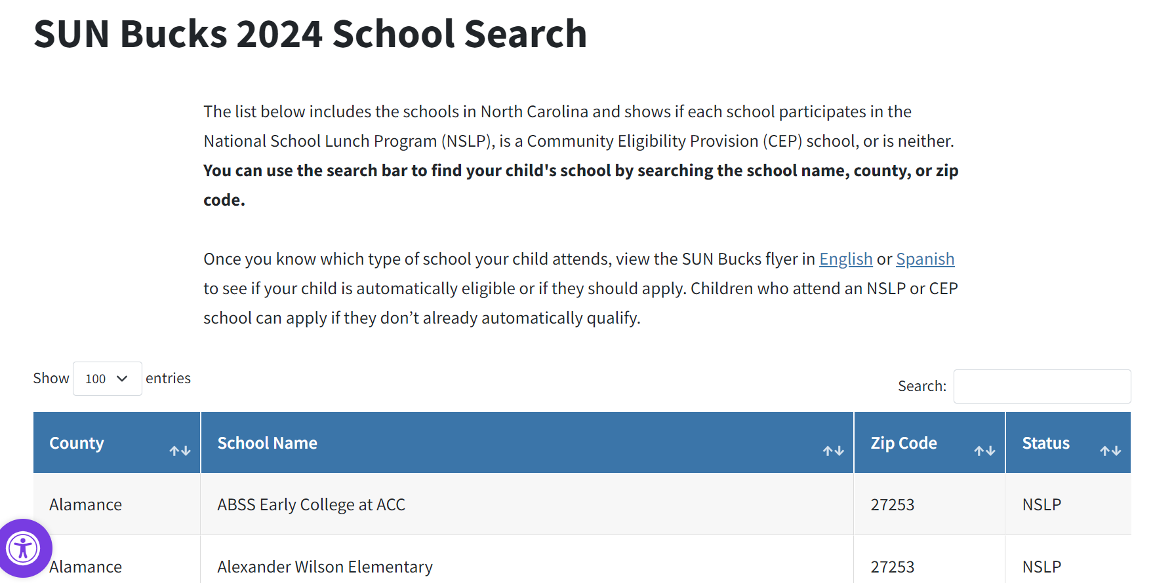
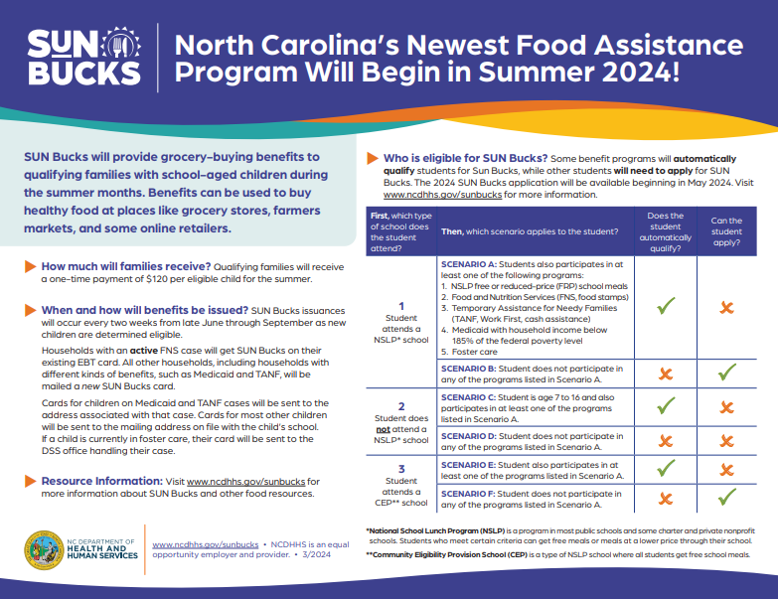
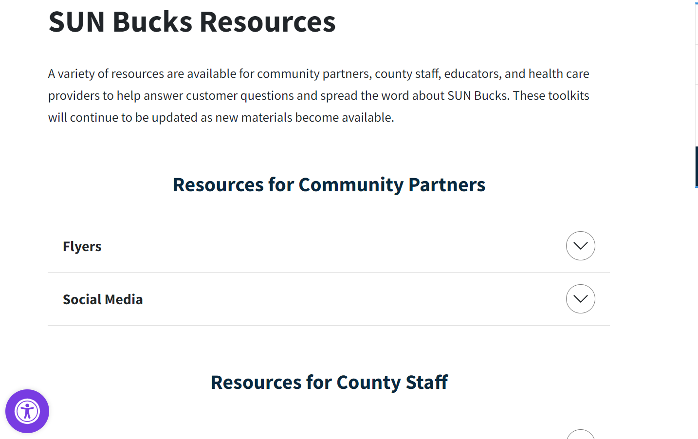
QUESTIONS? NCDHHS HAS A VARIETY OF Helpful sun bucks resources
SUN Bucks Webpage
The primary source for updated information.
Application Webpage
The primary source for application questions, including access to the application.
www.ncdhhs.gov/sunbucks
www.ncdhhs.gov/sunbucksapplication
Chat Bot & Eligibility Quiz
School Search Tool
Informational Flyers
Stakeholder Toolkits
Coming soon!

Slide 5
Sun bucks 2024 key dates
May 1st
^{2024 SUN Bucks}
^{application opened}
Mid-June
^{First SUN Bucks issuance}
August 31st
Last day to apply for Summer 2024 benefits
DCDL to be distributed
How can families access the SUN Bucks application?
Families who can apply will receive an invitation to apply by email with instructions as well as text.
Families can visit www.ncdhhs.gov/sunbucksapplication to complete a digital application. The online application is the easiest and fastest way to apply; paper applications will also be available in school offices.
A designated SUN Bucks call center is available to answer questions and can assist clients complete an application in Spanish. Families can call 1-866-719-0141 and press option 2 to speak with a SUN Bucks representative.
When will approved children receive their SUN Bucks benefits?
Benefits will start to be issued mid to late June and will continue through the summer as children are determined eligible.
Please assist Medicaid and TANF clients with updating their mailing address for their case in NC FAST (if needed), as their SUN Bucks card will be sent to their address on file. Counties would work undeliverable S-EBT cards associated with these cases.

Slide 6
SNAP Improved Beneficiary Experience (IBE) Projects
2

Slide 7
Adoption of snap IBE initiatives continues to trend upwards
Are your clients using the new ePASS account features?
Remote identity proofing is coming to North Carolina for FNS households! Once RIDP is implemented, clients will be able to verify their identity without coming into the office to take advantage of these features.
In the meantime, please ask clients if they would like to link their accounts during their next in-person visit.
Functionality |  | Adoption Data, as of 5/1/24
eNotices Deployed 12/17/23 | Subscribed Users | 71,767
 | Notices Sent | 56,722
Text Messaging Deployed 4/8/23 | Subscribed Users | 276,639
 | Static Messages Sent | 2,115
 | Secure Messages Sent | 147
SNAP Recerts* Deployed 7/15/23 | Started But Abandoned | 0**
 | Completed | 3
FNS Recerts Deployed 9/16/23 | Started But Abandoned | 56,772**
 | Completed | 35,806
SNAP CoCs Deployed 7/15/23 | Started But Abandoned | 5**
 | Completed | 6**
FNS CoCs Deployed 12/16/23 | Started But Abandoned | 13,470**
 | Completed | 5,625**
*Consideration for SNAP Recerts: The SNAP population is significantly smaller than the FNS population and recerts occur every 3 years, whereas FNS recerts occur every 6 months. Additionally, the SNAP population includes older demographics who may not be fully utilizing online functionalities.
**Not representative of unique cases.

Slide 8
Waivers
3

Slide 9
NC waiver – Interview- Beginning June 1, 2024
Effective June 1, 2024, NC has been approved for a phrase out interview waiver through 10/31/2024
What does this mean
County Required Action
Interview requirements as cited in 7 C.F.R. 273.2(a)(2), 273.2(e), and 273.14(b)(3) requires an interview at initial application, expedited service, and certain recertifications. All households that submit a valid application, which includes a name, address,
and signature must be interviewed. Unless the household is interviewed on the same day they submit their application, an interview must be scheduled.
The interview is the most important step in the certification process for the Food and Nutrition Services (FNS). It is an opportunity to ensure the FNS applications are complete, to engage with applicants to fully understand their household circumstances, and to provide the assistance needed to understand their responsibilities in the certification process.
Review - USDA' SNAP Interview Toolkit at https://fns.usda.gov/snap/state-agency-interview-toolkit
Explore and clarify the household’s circumstances and identify information that needs to be verified.
Screen the household for expedited service, work requirement exemptions, and student requirements.
Provide information to the applicant household regarding its rights and responsibilities under the FNS regulations and explain FNS program requirements.
Inform - interview requirement
Notes:
The toolkit describes that SNAP interview requirements and provides information on promising best practices. The toolkit is a resource for State SNAP agencies as they conduct interviews, train staff, and look for ways to improve their interview processes.

Slide 10
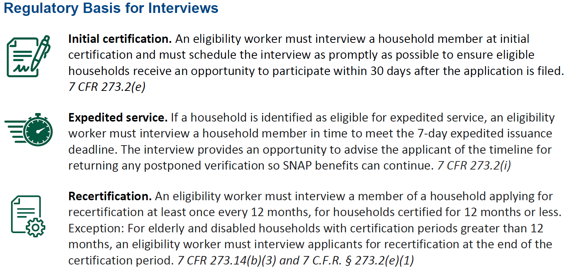
NC FNS was approved wavier to remove the certain recertification interview requirement. If approved, the recertification interview requirement will be waived through October 31, 2024.

Slide 11
Telephonic Signature Waiver
Approved July 1, 2024 – June 30, 2026
NC will continue to submit the telephonic signature waiver request as needed.

Slide 12
Expedite Delayed Determination
4

Slide 13
Expedited Late Determination Defect
NC DHHS is aware of the expediate late determination timeliness processing error.
Regulation
Current Defect
The timeliness code would count against the agency when the agency fails to correctly identify the application as expedited at application, when all information was available at application to make the correct determination, and the application is processed outside the processing standard of 7 days.
Federal SNAP Regulation 7 273.2(i)(3)(iv)
Late determinations: If the prescreening required in paragraph (i)(2) of this section fails to identify a household as being entitled to expedited service and the County subsequently discovers that the household is entitled to expedited service, the County shall provide expedited service to households within the processing standards described in paragraphs (i)(3) (i) and (ii) of this section, except that the processing standard shall be calculated from the date the County agency discovers the household is entitled to expedited service.
All late determinations whether client or agency error are flagged untimely.
NC DHHS is actively working on a fix. Follow up information will be forthcoming.
Notes:
if it was a client error - Date of App 3-19-2024, Client completed application and keyed income incorrectly in the expedited screening section. The client keyed income in as $10,000 instead of $1,000. The rent $1500 and pay utilities. Due to the income keyed incorrectly, the application was not expedited. Caseworker discovered the error 3-29-2024 that the case is now expedited.
This case would be expedited from the point of discovery, which would be 03/29/24. The household would be required to have access to their benefits within 7 days from 03/29/24. This case would be considered timely if the household has access to their benefits 7 days from 03/29/24. The agency expedited upon discovery. (See the highlighted portion of the regulation below.)
change of circumstance – Date of App 3-1-2024, Client reported only income is spouses’ income in the expedited screening section, income $3250, rent $1165 and pay utilities. On 3-9-2024 client report spouse is no longer in the home and provided proof. Now the case is expedited.
This scenario depends on how much income the household earned for the month of March. Without knowing when the income ended, and how much income was earned for the month of March, I cannot determine if the household is eligible for expedited services. If expenses exceeded the income for the application month or the household met other expedited circumstances for the application month, then the case would be expedited from the point of discovery. The agency would process the case from the date of discovery, which would be 03/09/24, if this is the date of interview. The household must have access to their benefits 7 days from the discovery date. The timeliness coding would be timely, if the household receives/has access to its benefits 7 days from 03/09/24. (See the highlighted portion of the regulation below.)
caseworker discovery - Date of App 4-2-2024, Client completed application and reported in the expedited screening section, income $1080, rent $860 and pay cell phone $100. During interview on 4-10-2024 the caseworker discovered the client also pays utilities. Now the case is expedited.
If the expenses exceed the income because a heating and cooling deduction was added, and this was discovered at the time of the interview, then the agency must expedite the case from the point of discovery. The point of discovery would be 04/10/24. The household must have access to their benefits by the 7th day. If the agency processes the case, and the client has access to their benefits by the 7th day, then the case would be timely. (See the highlighted portion of the regulation below.)

Slide 14
Training Update
5

Slide 15
Upcoming training Updates
FNS is working to update FNS orientation, provide DSNAP training and non-merit major change technical assistance..
100
Module being reviewed and comments collected from staff in 25 counties. Once complete, the module will be updated in Learning Gateway
200
Module being reviewed by DHHS training committee. Once complete, County staff will review and provide feedback.
D SNAP
June 10^{h} 12 pm; June 18th 1 pm; June 27th 3 pm
Non-Merit
June 12th 2 pm; June 14th 10 am
Notes:
IVR Balance Vendor will add prompts in the IVR flow to validate the caller before playing the balance:
Vendor will ask for the cardholder’s 16-digit card number
Vendor will ask for the cardholder’s eight (8) digit date of birth (DOB)
If the cardholder’s DOB is not in Vendor’s system (i.e., ebtEDGE), vendor will ask for the five (5) digit zip code.
If neither the DOB or zip code is in the Vendor’s system, then the call will end without playing the balance.
Vendor will allow the caller to enter a response to the validation prompt up to three (3) times. If there is no match after three (3) attempts, then the call will end without playing the balance.
2.Vendor will implement enhancement to add date of birth to validation when a North Carolina EBT cardholder is selecting/changing a PIN in the IVR or cardholder portal/mobile application,
or when linking a card in the cardholder portal/mobile application. Specific details of flows may be adjusted based on agreement by both parties via written approval.
Vendor will update the IVR PIN Select process to have the caller verify the following information on each PIN Select or PIN Change attempt:
If the Social Security Number (SSN) is valid, verify the eight (8) digit DOB (mm/dd/yyyy) and subsequently verify the last four (4) digits of SSN.
If the DOB is not valid, verify the five (5) digit zip code and subsequently verify the last four (4) digits of SSN.
If the SSN is not valid, verify the eight (8) digit DOB and subsequently verify the five (5) digit zip code.
If there is no valid SSN or zip code, then only verify eight (8) digit DOB.
If the SSN is not valid and no DOB, then verify only the five (5) digit zip code once.
If the SSN is not valid, no DOB, and no zip code, then transfer the call to the NC state EBT call center.
Vendor will update the cardholder portal/mobile application to verify the following information for a PIN Select or PIN Change request to link an EBT card to a registered user account:
If the SSN is valid, verify the eight (8) digit DOB (mm/dd/yyyy) and the last four (4) digits of SSN.
If the DOB is not valid, verify the five (5) digit zip code and the last four (4) digits of SSN.
If the SSN is not valid, verify the eight (8) digit DOB and five (5) digit zip code.
If there is no valid SSN or zip code, then only verify eight (8) digit DOB.
If the SSN is not valid and no DOB, then verify only the five (5) digit zip code once.
If the SSN is not valid, no DOB, and no zip code, then display the referral message as approved by the State.
3. Vendor will implement enhancement to block commonly used PINs from being selected by North Carolina EBT cardholders and prevent cardholders from re-selecting the current PIN value.
Vendor will disallow cardholders from selecting commonly used PINs via the cardholder portal/mobile application and IVR.
Vendor will disallow cardholders from selecting the current PIN as the new PIN value via the cardholder portal/mobile application and IVR.
Vendor will work with the State to determine up to 20 PIN values that cardholders will not be able to select.
Vendor will work with the State to set an implementation date for blocking common PINs.
Vendor will provide a message in the cardholder portal/mobile application as approved by the State to be displayed when a cardholder attempts to select or change a PIN to a PIN that is not allowed.
Vendor will speak the message “Your State does not allow the selection of PINs that are easy to guess such as 1234 or all of the same number such as all one’s, lets try selecting a different PIN” in the IVR when a cardholder attempts to select or change a PIN to a PIN that is not allowed.

Slide 16
Upcoming EBT Secuity Enhancements
FIS Contract has been amended to include the following security enhancement that will be implemented soon.
IVR Balance
Vendor will implement enhancement to add validation of the primary cardholder’s date of birth before playing the balance in the North Carolina Customer Service Interactive Voice Response (IVR):
PIN
Implement enhancement to add date of birth to validation when a North Carolina EBT cardholder is selecting/changing a PIN in the IVR or cardholder portal/mobile application
Commonly used PINs
Implement enhancement to block commonly used PINs from being selected by North Carolina EBT cardholders and prevent cardholders from re-selecting the current PIN value.
Notes:
IVR Balance Vendor will add prompts in the IVR flow to validate the caller before playing the balance:
Vendor will ask for the cardholder’s 16-digit card number
Vendor will ask for the cardholder’s eight (8) digit date of birth (DOB)
If the cardholder’s DOB is not in Vendor’s system (i.e., ebtEDGE), vendor will ask for the five (5) digit zip code.
If neither the DOB or zip code is in the Vendor’s system, then the call will end without playing the balance.
Vendor will allow the caller to enter a response to the validation prompt up to three (3) times. If there is no match after three (3) attempts, then the call will end without playing the balance.
2.Vendor will implement enhancement to add date of birth to validation when a North Carolina EBT cardholder is selecting/changing a PIN in the IVR or cardholder portal/mobile application,
or when linking a card in the cardholder portal/mobile application. Specific details of flows may be adjusted based on agreement by both parties via written approval.
Vendor will update the IVR PIN Select process to have the caller verify the following information on each PIN Select or PIN Change attempt:
If the Social Security Number (SSN) is valid, verify the eight (8) digit DOB (mm/dd/yyyy) and subsequently verify the last four (4) digits of SSN.
If the DOB is not valid, verify the five (5) digit zip code and subsequently verify the last four (4) digits of SSN.
If the SSN is not valid, verify the eight (8) digit DOB and subsequently verify the five (5) digit zip code.
If there is no valid SSN or zip code, then only verify eight (8) digit DOB.
If the SSN is not valid and no DOB, then verify only the five (5) digit zip code once.
If the SSN is not valid, no DOB, and no zip code, then transfer the call to the NC state EBT call center.
Vendor will update the cardholder portal/mobile application to verify the following information for a PIN Select or PIN Change request to link an EBT card to a registered user account:
If the SSN is valid, verify the eight (8) digit DOB (mm/dd/yyyy) and the last four (4) digits of SSN.
If the DOB is not valid, verify the five (5) digit zip code and the last four (4) digits of SSN.
If the SSN is not valid, verify the eight (8) digit DOB and five (5) digit zip code.
If there is no valid SSN or zip code, then only verify eight (8) digit DOB.
If the SSN is not valid and no DOB, then verify only the five (5) digit zip code once.
If the SSN is not valid, no DOB, and no zip code, then display the referral message as approved by the State.
3. Vendor will implement enhancement to block commonly used PINs from being selected by North Carolina EBT cardholders and prevent cardholders from re-selecting the current PIN value.
Vendor will disallow cardholders from selecting commonly used PINs via the cardholder portal/mobile application and IVR.
Vendor will disallow cardholders from selecting the current PIN as the new PIN value via the cardholder portal/mobile application and IVR.
Vendor will work with the State to determine up to 20 PIN values that cardholders will not be able to select.
Vendor will work with the State to set an implementation date for blocking common PINs.
Vendor will provide a message in the cardholder portal/mobile application as approved by the State to be displayed when a cardholder attempts to select or change a PIN to a PIN that is not allowed.
Vendor will speak the message “Your State does not allow the selection of PINs that are easy to guess such as 1234 or all of the same number such as all one’s, lets try selecting a different PIN” in the IVR when a cardholder attempts to select or change a PIN to a PIN that is not allowed.

Slide 17
EBT Processor Secuity Enhancements
6

Slide 18
Upcoming EBT Secuity Enhancements
FS Contract has been amended to include the following security enhancement that will be implemented soon.
IVR Balance
Vendor will implement enhancement to add validation of the primary cardholder’s date of birth before playing the balance in the North Carolina Customer Service Interactive Voice Response (IVR):
PIN
Implement enhancement to add date of birth to validation when a North Carolina EBT cardholder is selecting/changing a PIN in the IVR or cardholder portal/mobile application
Commonly used PINs
implement enhancement to block commonly used PINs from being selected by North Carolina EBT cardholders and prevent cardholders from re-selecting the current PIN value.
Notes:
IVR Balance Vendor will add prompts in the IVR flow to validate the caller before playing the balance:
Vendor will ask for the cardholder’s 16-digit card number
Vendor will ask for the cardholder’s eight (8) digit date of birth (DOB)
If the cardholder’s DOB is not in Vendor’s system (i.e., ebtEDGE), vendor will ask for the five (5) digit zip code.
If neither the DOB or zip code is in the Vendor’s system, then the call will end without playing the balance.
Vendor will allow the caller to enter a response to the validation prompt up to three (3) times. If there is no match after three (3) attempts, then the call will end without playing the balance.
2.Vendor will implement enhancement to add date of birth to validation when a North Carolina EBT cardholder is selecting/changing a PIN in the IVR or cardholder portal/mobile application,
or when linking a card in the cardholder portal/mobile application. Specific details of flows may be adjusted based on agreement by both parties via written approval.
Vendor will update the IVR PIN Select process to have the caller verify the following information on each PIN Select or PIN Change attempt:
If the Social Security Number (SSN) is valid, verify the eight (8) digit DOB (mm/dd/yyyy) and subsequently verify the last four (4) digits of SSN.
If the DOB is not valid, verify the five (5) digit zip code and subsequently verify the last four (4) digits of SSN.
If the SSN is not valid, verify the eight (8) digit DOB and subsequently verify the five (5) digit zip code.
If there is no valid SSN or zip code, then only verify eight (8) digit DOB.
If the SSN is not valid and no DOB, then verify only the five (5) digit zip code once.
If the SSN is not valid, no DOB, and no zip code, then transfer the call to the NC state EBT call center.
Vendor will update the cardholder portal/mobile application to verify the following information for a PIN Select or PIN Change request to link an EBT card to a registered user account:
If the SSN is valid, verify the eight (8) digit DOB (mm/dd/yyyy) and the last four (4) digits of SSN.
If the DOB is not valid, verify the five (5) digit zip code and the last four (4) digits of SSN.
If the SSN is not valid, verify the eight (8) digit DOB and five (5) digit zip code.
If there is no valid SSN or zip code, then only verify eight (8) digit DOB.
If the SSN is not valid and no DOB, then verify only the five (5) digit zip code once.
If the SSN is not valid, no DOB, and no zip code, then display the referral message as approved by the State.
3. Vendor will implement enhancement to block commonly used PINs from being selected by North Carolina EBT cardholders and prevent cardholders from re-selecting the current PIN value.
Vendor will disallow cardholders from selecting commonly used PINs via the cardholder portal/mobile application and IVR.
Vendor will disallow cardholders from selecting the current PIN as the new PIN value via the cardholder portal/mobile application and IVR.
Vendor will work with the State to determine up to 20 PIN values that cardholders will not be able to select.
Vendor will work with the State to set an implementation date for blocking common PINs.
Vendor will provide a message in the cardholder portal/mobile application as approved by the State to be displayed when a cardholder attempts to select or change a PIN to a PIN that is not allowed.
Vendor will speak the message “Your State does not allow the selection of PINs that are easy to guess such as 1234 or all of the same number such as all one’s, lets try selecting a different PIN” in the IVR when a cardholder attempts to select or change a PIN to a PIN that is not allowed.

Slide 19
What Questions Are There?
7

