Slide 1
Adult Protection Network UNC School of Government June 12, 2024

Slide 2
Project History
(2017) Contract with NC Conference of Clerks of Superior Court and NC Administrative Office of the Courts to use grant funding from the Governor’s Crime Commission distributed through Victims of Crime Act
(2020) NC Collaboratory Funding (COVID- 19)
NC Division of Aging and
Adult Services (COVID-19)
(2024) NC Division of Aging and Adults Services (COVID-19)

Slide 3
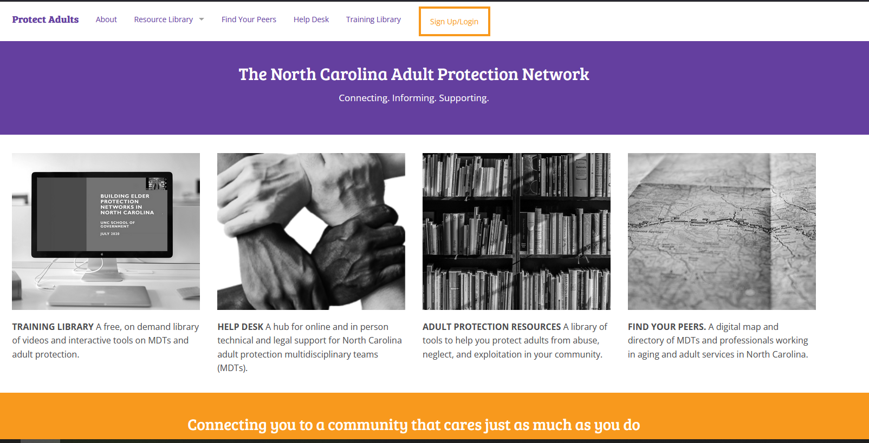
Adult Protection Network Website: https://protectadults.sog.unc.edu

Slide 4
Audience Check-In
Have you visited the Adult Protection Network website? Type “yes” or “no” in the chat box.

Slide 5
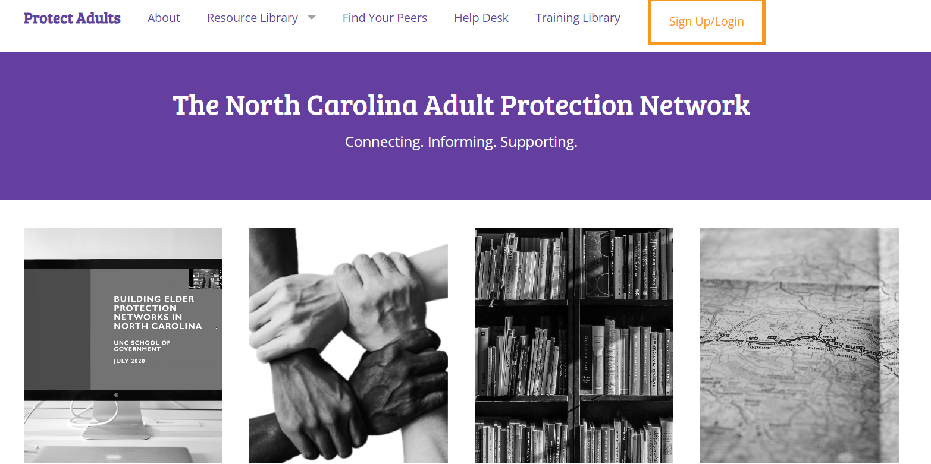
Adult Protection Network Website

Slide 6
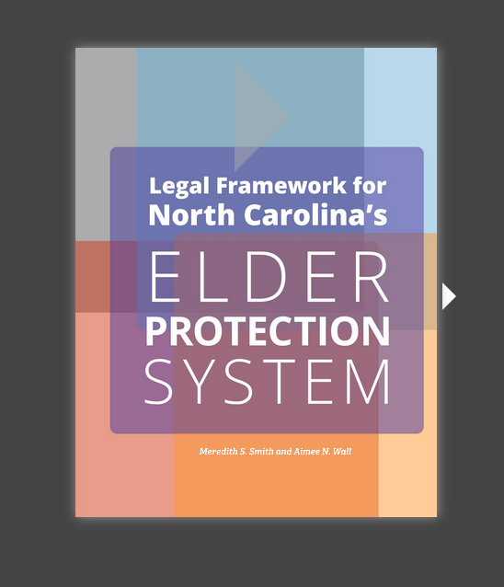

Slide 7
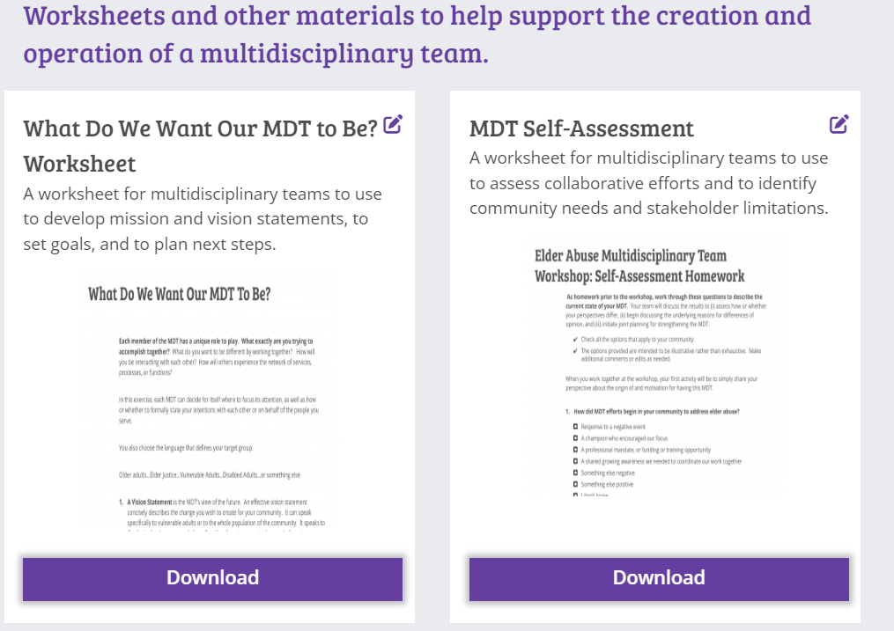

Slide 8
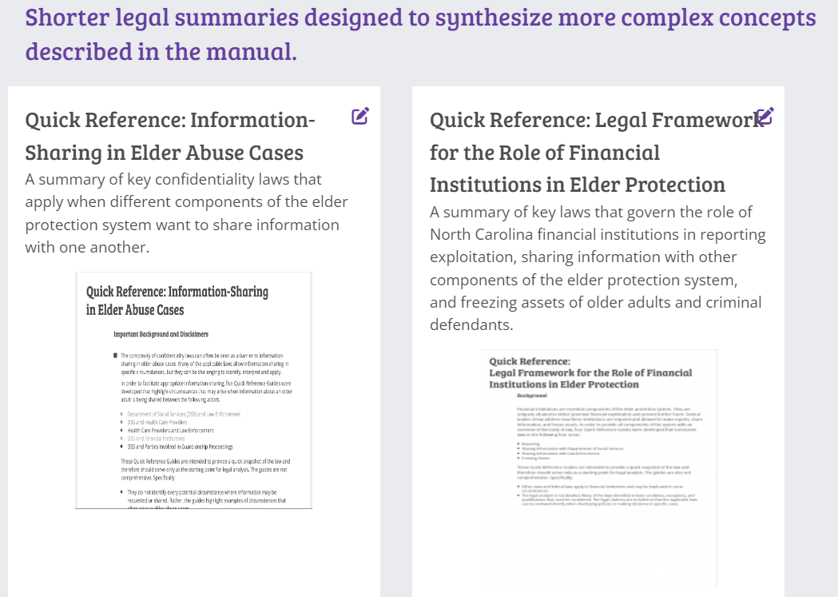

Slide 9
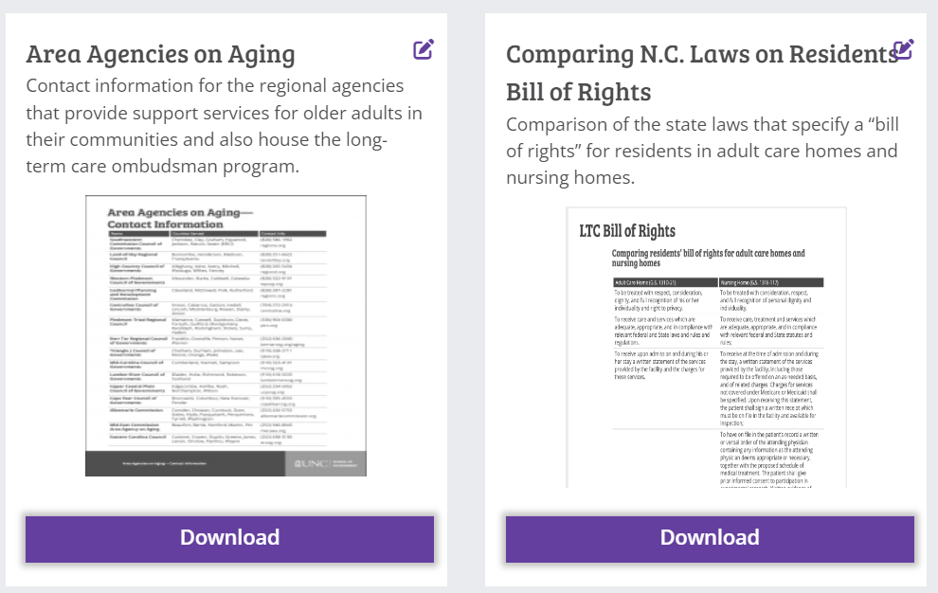

Slide 10
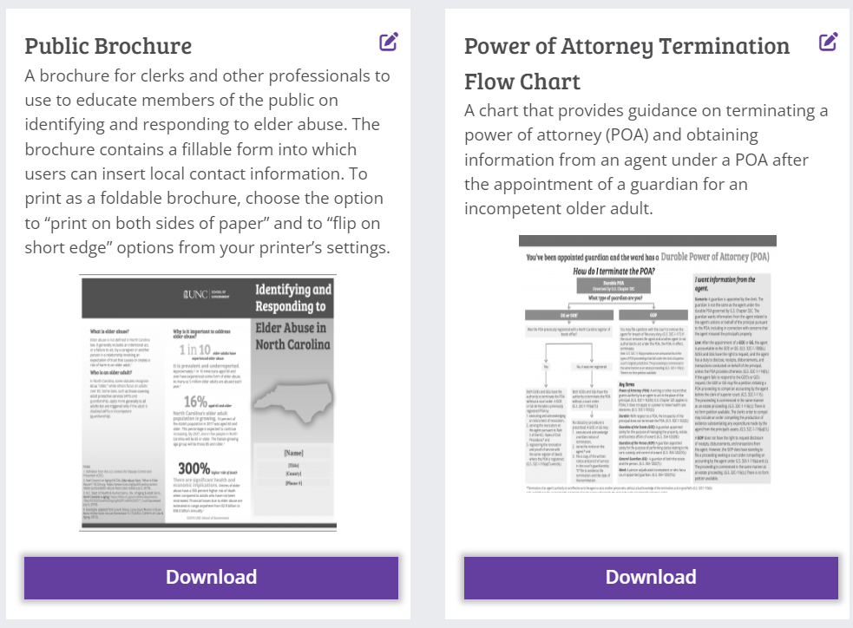

Slide 11
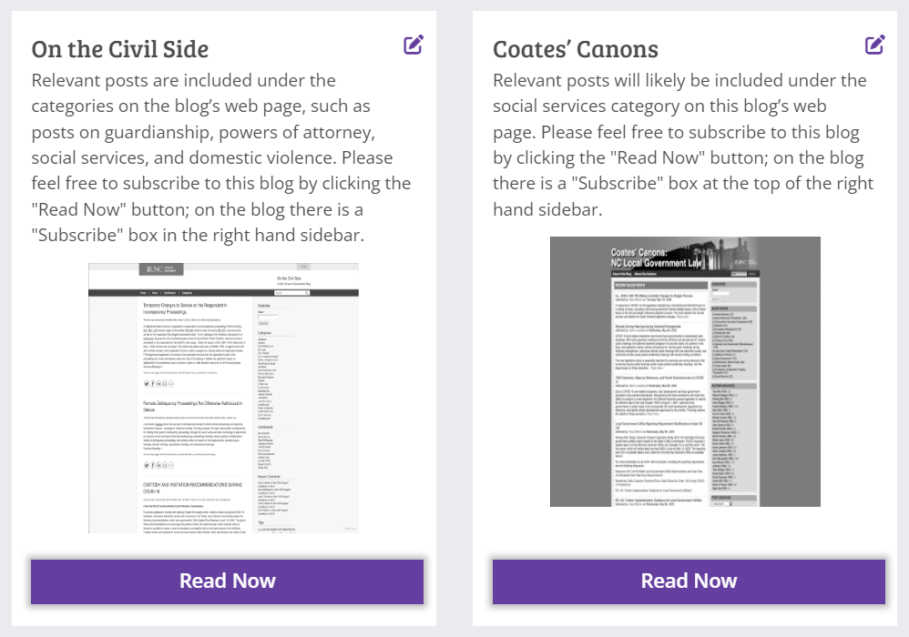

Slide 12
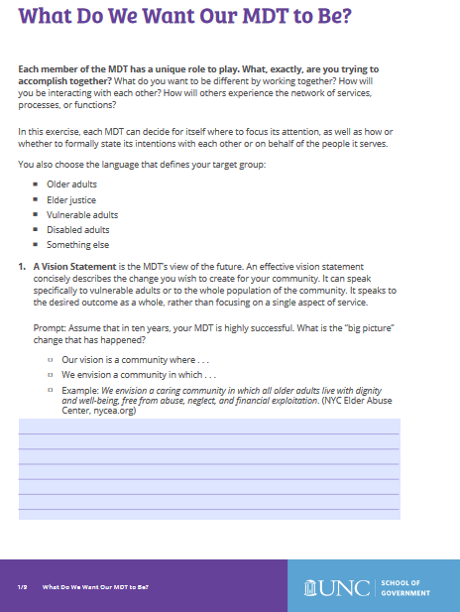
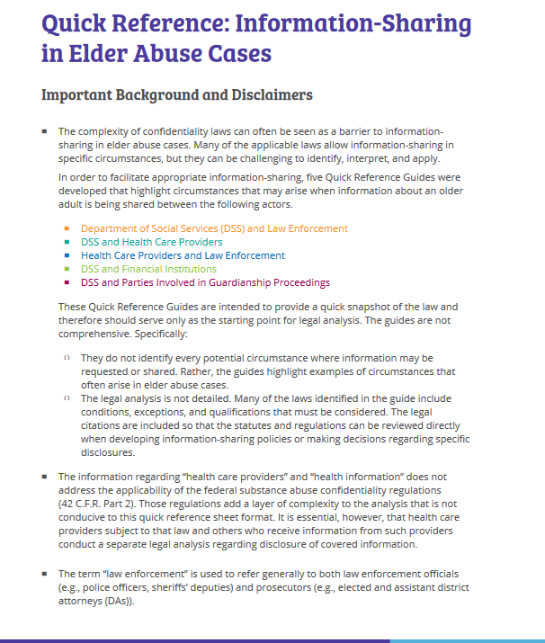
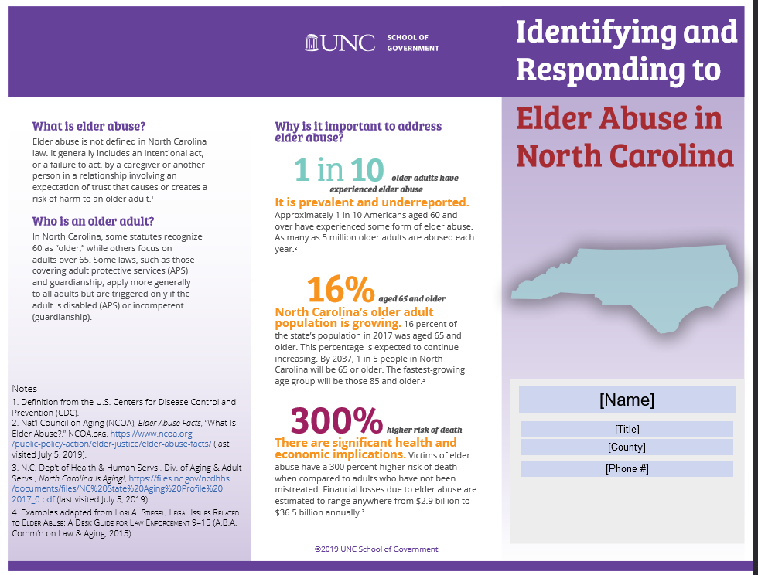

Slide 13
Audience Check-In
Have you used any of the Resources from the Adult Protection Network website? Type “yes” or “no” in the chat box.

Slide 14
Adult Protection Network Website

Slide 15
How many counties in North Carolina have Adult Protection Multidisciplinary Teams?
a. 15
b. 31
c. 49
d. 61

Slide 16
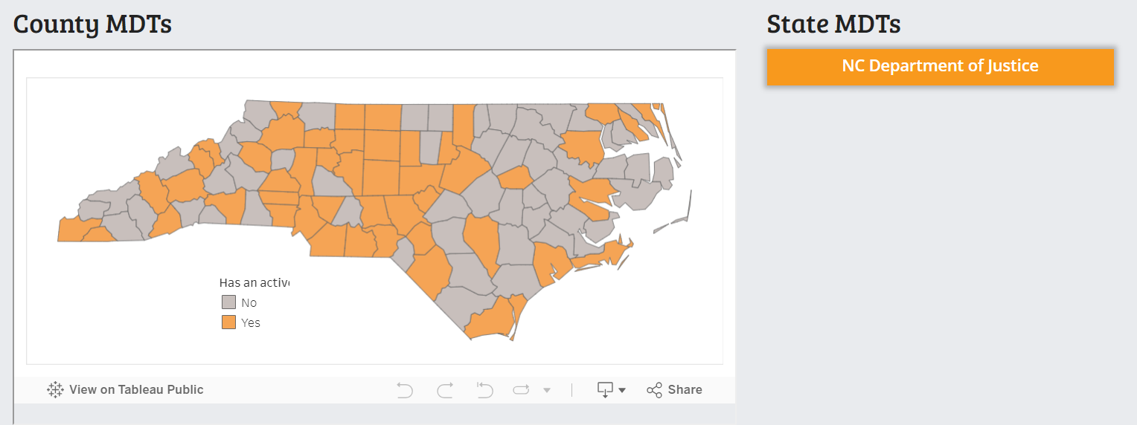
Find Your Peers Map

Slide 17
Adult Protection Network Website

Slide 18
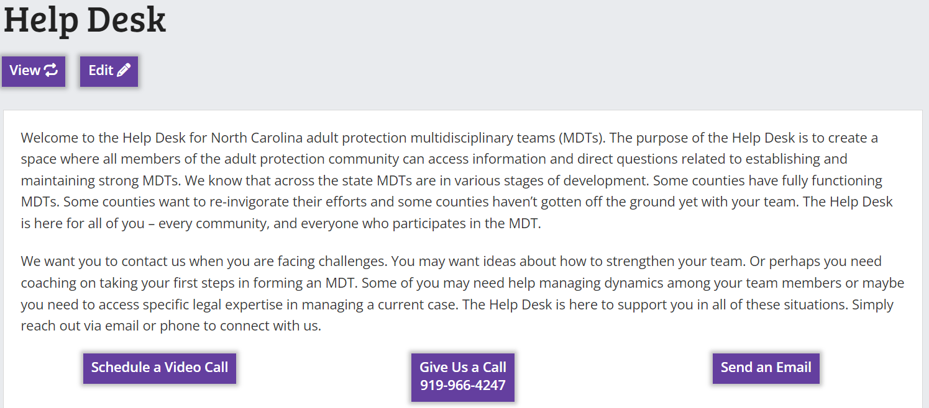
Adult Protection Network Help Desk: Contact

Slide 19
Adult Protection Network Help Desk: FAQs

Slide 20
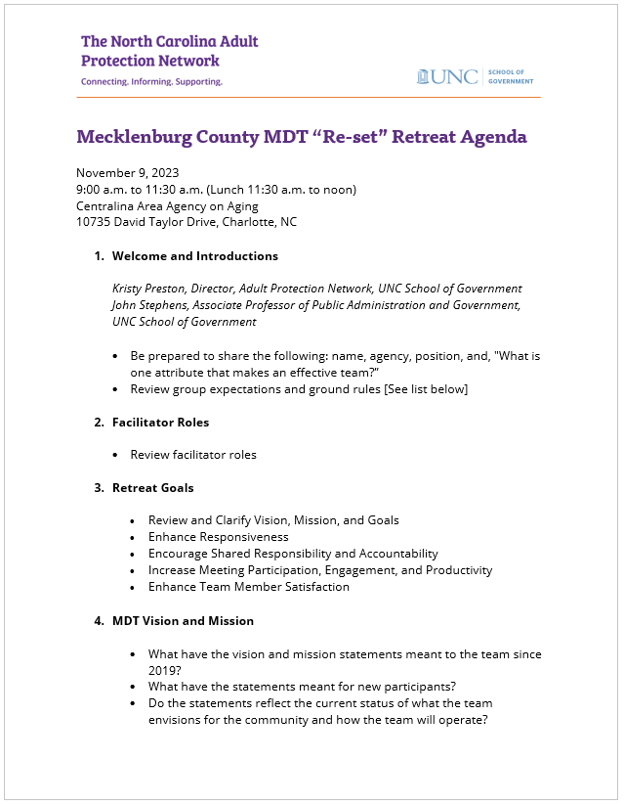
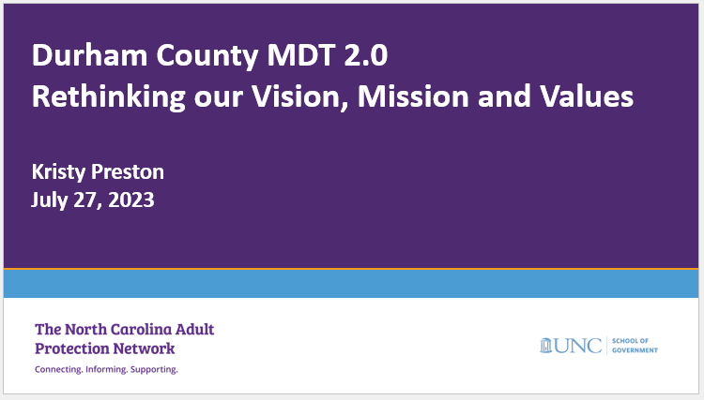
Adult Protection Network Help Desk : Consultation

Slide 21
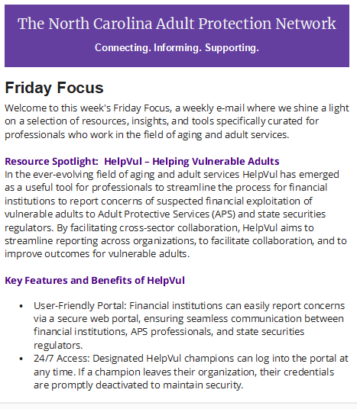
Adult Protection Network Help Desk: Weekly APN Emails

Slide 22
Audience Check-In
Do you get the Training Tuesday and Friday Focus emails? Type “yes” or “no” in the chat box.

Slide 23
Adult Protection Network Help Desk: Connections
This Photo by Unknown Author is licensed under CC BY-NC-ND

Slide 24
How many counties in North Carolina have connected with the Help Desk for support?
a. 19
b. 36
c. 50
d. 61

Slide 25
Adult Protection Network Website

Slide 26
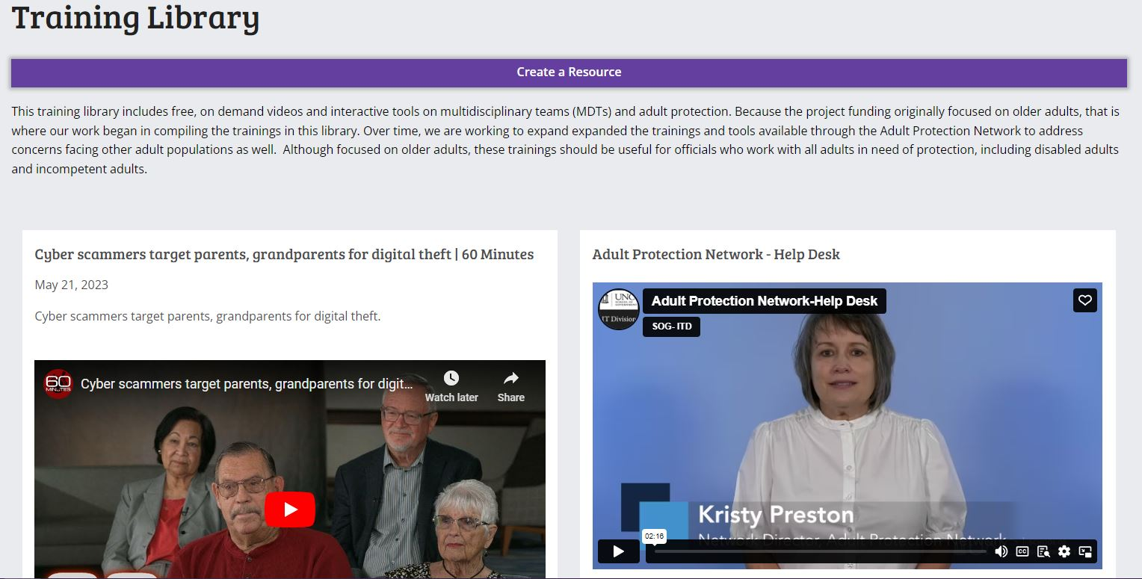

Slide 27
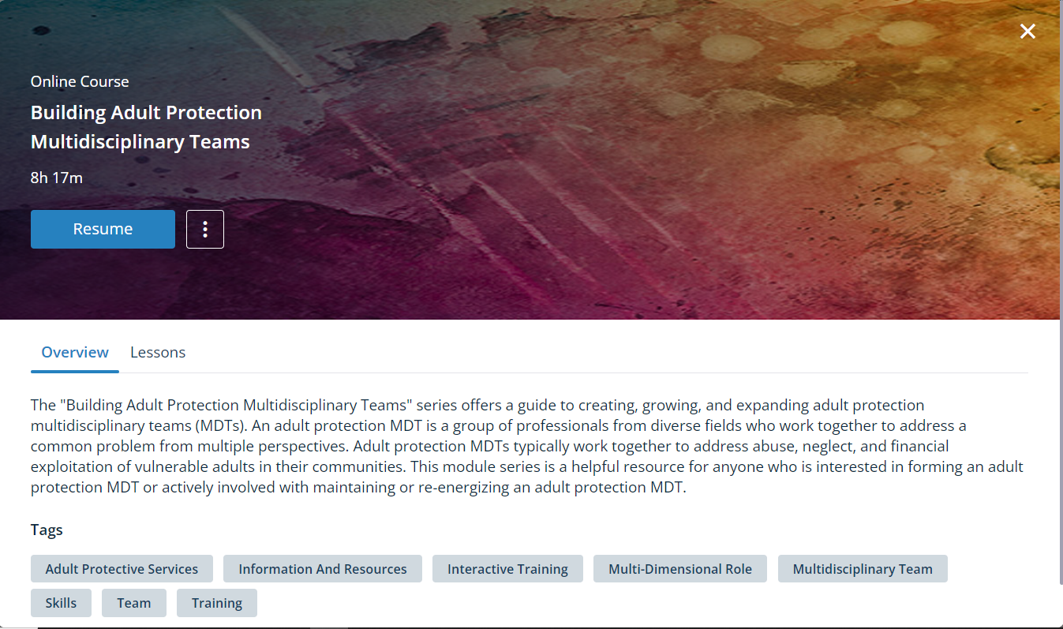
Module Series: Building Adult Protection Multidisciplinary Teams
What: 13 e-learning modules
Audience: Current and potential MDT members
Availability: Adult Services Learning
Management System
Coming soon to the APN website!

Slide 28
Audience Check-In
Have you accessed the e-learning modules from the Adult Services Learning Management System? Type “yes” or “no” in the chat box.

Slide 29
Adult Protection Network
January 2024 – September 2024
UNC School of Government
NC Division of Aging and Adult Services

Slide 30
Current Grant Project Goals
Create an advanced MDT training pathway
Develop an MDT Toolkit
Continue Help Desk services

Slide 31
Current Grant Project Goals
Advanced MDT Training Pathway
Law enforcement and prosecutors
Adult protective services
Mental health
Guardianship
Confidentiality and information sharing
This Photo by Unknown Author is licensed under CC BY-SA

Slide 32
Current Grant Project Goals
Develop an MDT toolkit
Model written consent form
MOU
Recruitment letter – new team
Recruitment letter – reestablishing
Recruitment letter – adding new members
Needs assessment worksheet
Others needed?
This Photo by Unknown Author is licensed under CC BY-NC

Slide 33
Current Grant Project Goals
Continue Help Desk services
Maintain the APN website
Continue weekly emails – Training Tuesday and Friday Focus
Provide guidance to counties as requested
Provide in-person and virtual support to county MDTs
Coming soon: Regional MDT Coordinator meetings

Slide 34
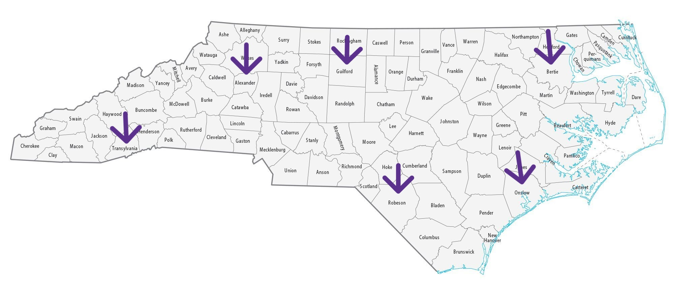
The MDT Booster Shot Series
June 25, 2024 – Guilford County
July 11, 2024 – Alexander County
July 12, 2024 – Transylvania County
July 19, 2024 – Onslow County
August 6, 2024 – Robeson County
August 2024 – Bertie County (Date TBA)

Slide 35
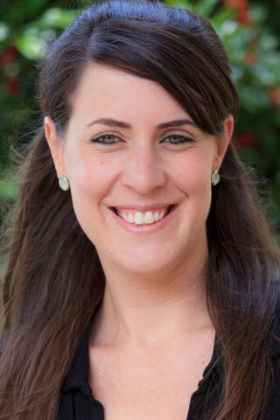
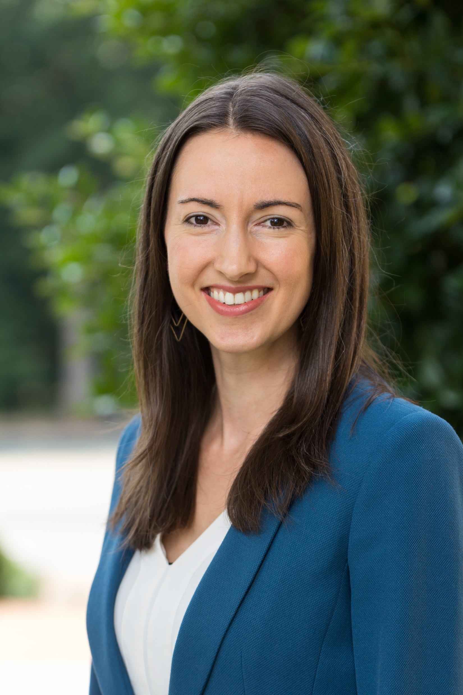
The Team
Kristy Preston
Meredith Smith
Kristi Nickodem

Slide 36
Red = Help! I need more information. Yellow = I’m not sure about this. I need to think about it but I may need more information. Green = I’m all set. I know how and when to call the Adult Protection Network!
Stoplight Exit Ticket
This Photo by Unknown Author is licensed under CC BY-SA

Slide 37
Questions?
kpreston@sog.unc.edu

